Slide 1
An efficient CNN-based classification on G-protein Coupled Receptors using TF-IDF and N-gram
Man Li et. al.
Beijing university, China

Slide 2
INTRODUCTION BACKGROUND G-Protein Coupled Receptors TF-IDF Convolutional Neural Network MATERIALS AND METHOD Experimental Dataset N-gram feature extraction GPCRs family level classification DISCUSSION CONCLUSION

Slide 3
INTRODUCTION
Protein sequence classification methods:
Models based on sequence alignment and motifs
Appeared first
Pair-wise sequence → a score matrix whose value corresponding to the similarity score of the relevant problem
Flaws in alignment methodology
Unreliable alignments are often provided when the similarities between aligned sequences are less than 40%
Model based on machine learning algorithms
Input features can be:
Protein sequence via n-gram
Prototypes found by variable length fuzzy genetic clustering algorithm
Derived from encoding technique
PSSM

Slide 4
INTRODUCTION
Goal
Application of using Convolutional Neural Network (CNN) in conjunction with an improved n-gram feature extraction method and Term Frequency - Inverse Document Frequency (TF-IDF) weighting strategy to classify G-protein Coupled Receptors (GPCRs) at different levels

Slide 5
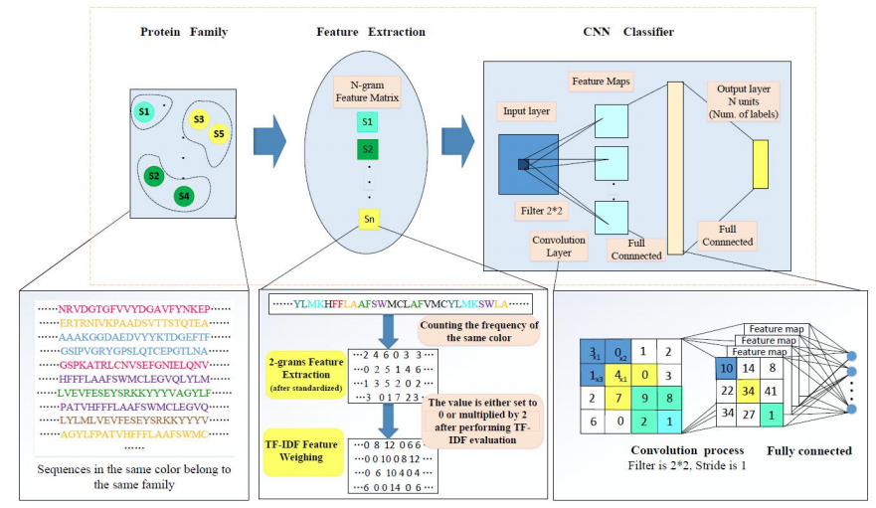
INTRODUCTION
The implementation architecture of the proposed methodology

Slide 6
BACKGROUND G-Protein Coupled Receptors
Comprise a large and varied multi-gene super family which contains integral membrane proteins directly implicated incalculable physiological functions
Some are with domination of pathways and mechanisms that manage many momentous functions in many different species, including humans
GPCRs also apperceive all kinds of signals ranging from olfactory to visual
GPCRs have a critical position as receptors for outside ligands and actuators for internal processes and establish the sensory and regulatory connection of the cell with the outside world
Besides, GPCRs protein sequences are used in the drug design industry in most cases and target roughly 50% of modern drugs

Slide 7
BACKGROUND G-Protein Coupled Receptors
Only found in eukaryotes
Comprise of the largest known class of membrane receptors
Human have more than 1000 known types of GPCRs
Each one is specific to a particular function
They are unique to membrane receptors
They are the target of around to 30 to 50% of mordern drugs
The ligands that binds:
Range from things like light sensitive compounds to odors, pheromones, hormones and even neurotransmitters
Can regulate the immune system, growth, our sense of smell, taste, visual, behavioral and our mood
Until now, many G-protein and GPCRs still have unknown functions and is a topic heavily researched
2012- Nobel prize in chemistry was awarded for research on GPCRs
https://www.youtube.com/watch?v=ZBSo_GFN3qI&t=3s

Slide 8
BACKGROUND TF-IDF
Is a statistical method used to evaluate the importance of a word from a document or a document from a corpus.
It assumes that the importance of a word is directly proportional to the quantity of appearance in the document, and is inversely proportional with the frequency it appears in the other documents of corpus.

Slide 9
BACKGROUND TF-IDF
In the proposed study, a feature that has a greater appearing frequency in a sequence, but has a lower appearing frequency in the other sequences will be considered as a high distinguishing feature, the weight of which should be boosted.
Did not prune away non-informative features to reduce the dimension of feature space, but reassign the weight of non-informative features. Hence, the feature size of each sequence under classification remains the same as pre-processing after performing TF-IDF strategy.

Slide 10
BACKGROUND TF-IDF
TF-IDF is intended to reflect how relevant a term is in a given document
TF-IDF consist of 2 parts:
TF: (term frequency)
and IDF( inverse document frequency)
Reference with codes
https://www.kdnuggets.com/2018/08/wtf-tf-idf.html

Slide 11
BACKGROUND TF-IDF
Intution: that if a word occurs multiple times in a document, we should boost its relevance as it should be more meaningful than other words that appear fewer times (TF). At the same time, if a word occurs many times in a document but also along many other documents, maybe it is because this word is just a frequent word; not because it was relevant or meaningful (IDF).

Slide 12
BACKGROUND TF-IDF
Intution: relevant words are not necessarily the most frequent words since stopwords like “the”, “of” or “a” tend to occur very often in many documents.

Slide 13
BACKGROUND TF-IDF
Another way to know: if we want to summarize a document compared to a whole dataset about an specific topic (i.e: movie reviews), there will be words (other than stopwords, like character or plot or release or revenue ), that could occur many times in the document as well as in many other documents. These words are not useful to summarize a document because they convey little discriminating power; they say very little about what the document contains compared to the other documents.

Slide 14
BACKGROUND TF-IDF
Example1: Search engine application
Search query: “the furry cat”
Query results: “the lovely cat”¹ and “a furry kitten”²
How TF-IDF can help?
TF: is the same for each word: TF(the)=TF(furry)=TF(cat)=1
IDF: the terms “cat” would appear in many documents (large document frequency implies low IDF), while the term “furry” will appear in fewer documents (larger IDF)
Conclusion: If we use the TF-IDF to weight the different words that matched the query, “furry” would be more relevant than “cat” and so we could eventually choose “the furry kitten”² as the best match.

Slide 15
BACKGROUND TF-IDF
Example2: Document summarization application
Task: Automatically summarize some movies using their wikipedia pages
Moana movie Most frequent: [‘film’, ‘moana’, ‘the’, ‘million’, ‘disney’, ‘maui’, ‘day’, ‘release’, ‘te’, ‘animation’, ‘weekend’, ‘heart’, ‘ocean’, ‘it’, ‘story’, ‘island’, ‘fiti’, ‘version’, ‘in’, ‘animate’]
How TF-IDF can help?
TF-IDF: [‘maui’, ‘te’, ‘moana’, ‘fiti’, ‘cravalho’, ‘goddess’, ‘tui’, ‘polynesian’, ‘tala’, ‘kā’, ‘māori’, ‘auliʻi’, ‘clement’, ‘fishhook’, ‘tamatoa’, ‘jemaine’, ‘tattoo’, ‘dubbing’, ‘musker’, ‘clements’]
Conclusion: film, million or release have disappeared from the top of the list and we got some new more meaningful words like polynesian or tattoo

Slide 16
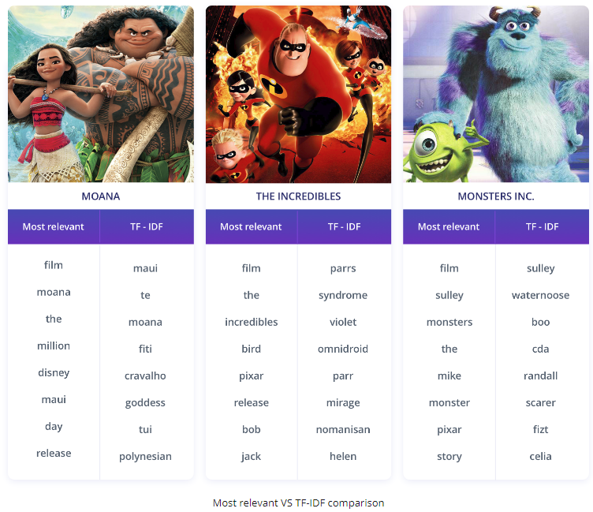

Slide 17
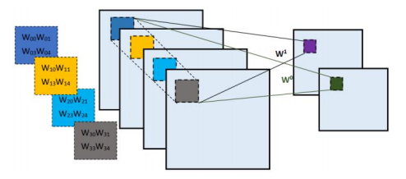
BACKGROUND Convolutional Neural Network
The process of convolution operations by different convolution kernels

Slide 18
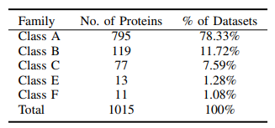
MATERIALS AND METHOD Experimental Dataset
Level I GPCRs subfamily
Family A is the family with the highest interest from pharmaceutical research perspective
Family B is one of key families in hormonal homeostasis diverting drug targets for the treatment of several metabolic disorders and nervous system diseases
Family C is a target of cardinal significance for new treatments recently, such as anxieties, pains, neurodegenerative disorders and antispasmodics.
Table 1: Distribution of the sequences
in GPCRs super family

Slide 19
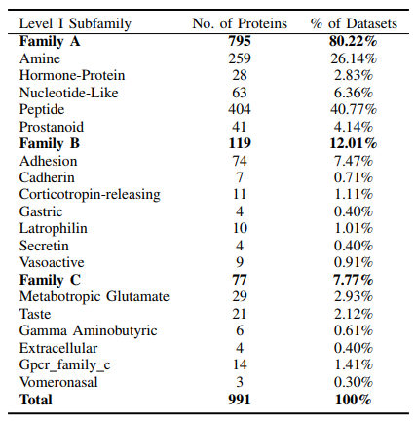
MATERIALS AND METHOD Experimental Dataset
Table 2: There are a total number of 18 subfamilies
The maximum peptide subfamily in Family A comprises 40.77% of the dataset. The subfamilies of Family A and Family C can be further divided into level II GPCRs subfamily (Table 3)
Table 2: Distribution of level 1 GPCRs subfamily in class A , B and C used in the proposed protein sequence classification

Slide 20
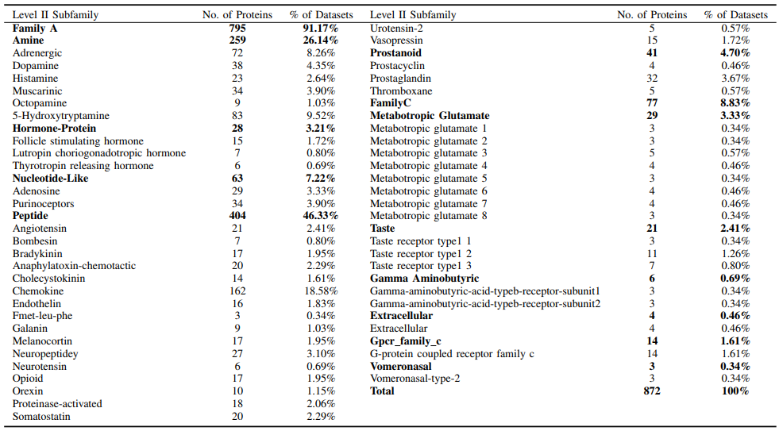
MATERIALS AND METHOD Experimental Dataset
There are 872 sequences that are categorized into 48 classes. Obviously, Family A is widely distributed throughout 32 classes outweighing Family C (16 classes).
This study focuses on classifying these datasets into family level, level I and level II GPCRs subfamily
Table 3: Distribution of level 2 GPCRs subfamily in class A and C used in the proposed protein sequence classification

Slide 21
MATERIALS AND METHOD N-gram feature extraction
Introduction to Language Models
N-gram language model
https://vitalflux.com/n-gram-language-models-explained-examples/

Slide 22


Introduction to Language Models
Language models is used to determine the probability of occurrence of a sentence or a sequence of words
2 ways to create a language model
Scenario 1: The probability of a sequence of words is calculated based on the product of probabilities of each word.
Scenario 2: The probability of a sequence of words is calculated based on the product of probabilities of words given occurrence of previous words.
P(“best websites for comparing car insurance”)= P(best/startOfSentence)P(websites/best)P(for/websites)…P(endOfSentence/insurance)
https://vitalflux.com/n-gram-language-models-explained-examples/

Slide 23



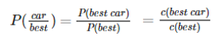


N-Grams Language Models
Language models is used to determine the probability of occurrence of a sentence or a sequence of words
N-grams is also termed as a sequence of n words → The language model which is based on determining probability based on the count of the sequence of words can be called as N-gram language model
Unigram: Sequence of just 1 word
Bigram: Sequence of 2 words
Trigram: Sequence of 3 words

Slide 24

MATERIALS AND METHOD N-gram feature extraction
How this paper applied the N-gram model?
Sequence: “MERQLEFME”
Count the number of 2-gram: ME, ER, RQ, QL, LE, EF, FM is 2, 1, 1, 1, 1, 1, 1 respectively and the rest number of possible 2-gram combinations are 0.
Use the occurrence frequency of n-gram to obtain the global structure:
sumi,j: the number of occurrences of feature j using i-gram ( i= 1, 2...n )
|S|: the number of features that can be extracted in the sequence when using i-gram
occurrence frequency of n-gram:

Slide 25
MATERIALS AND METHOD N-gram feature extraction
How this paper applied the N-gram model?
Each calculated frequency value regarded as a feature will compose the input matrix of CNN classifier
The total number of possible features grows at an exponential rate with the increase of i.
Instead of using only a single fixed n-gram, n-gram of length 1, 2 and 3 and different combinations among these grams were used by trial-and-error to find the best feature bindings to produce new classification criterion.
In accordance with this notion, the total number of input features is accumulated by used grams

Slide 26


MATERIALS AND METHOD N-gram feature extraction
TF-IDF for feature-weighting
Normalized TF for n-gram were calculated (normalized: in favor of long sequence)
n_{i,j} denote the appearance times of a n-gram feature i in sequence j, k denote the number of fragments with the same length in sequence j. Thus, the denominator refers to the total number of n-gram features in a sequence
Inverse Document Frequency (IDF) is a measurement indicating the importance of a given feature
numerator is the total number of sequences in dataset, the denominator is the number of sequences containing a feature

Slide 27

MATERIALS AND METHOD N-gram feature extraction
TF-IDF for feature-weighting
The TF-IDF is then obtained by multiplying the two values
The employment of TF-IDF:
filters out commonly appeared features and retains important features
original n-gram features were then boosted or degraded if their TF-IDF values beyond a threshold
Afterwards, these features are presented as a two-dimensional matrix and flow to the Convolutional Neural Network (CNN)

Slide 28

EXPERIMENTAL RESULTS Evaluation
The proposed method is evaluated on GPCRs at family level, level I and level II subfamily with different configurations of n-gram
For a persuasive measure, the experiments are also carried out by building feature matrices without TF-IDF strategy
A two-fold cross-validation is performed to eliminate the over-fitting in the classification of the entire datasets
The following criterion is defined to evaluate the performance of the classification

Slide 29
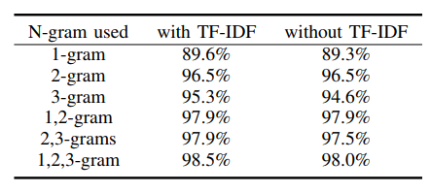
EXPERIMENTAL RESULTS GPCRs family level classification
In practices, the effort of using 2-gram and 3-gram is topgallant. It results in an extreme sparseness of features and large memory consumption if the number of terms is more than 3.
In addition to including the performance of using TF-IDF, the experiments are also carried out without using TF-IDF.
Table 4: The classification accuracy of the proposed method at GPCRs family level

Slide 30
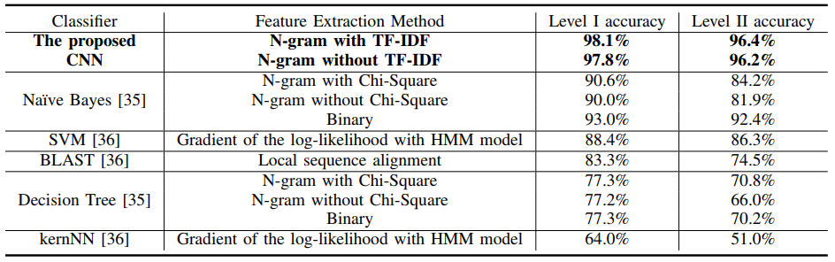
EXPERIMENTAL RESULTS level I and II GPCRs subfamily classification
Next the proposed method is applied to classify level I and II GPCRs subfamilies
Table 5: The comparisons of various classifiers on the classification accuracy at GPCRs level I and II subfamily

Slide 31
DISCUSSION
The key challenge in GPCRs sequence classification using machine learning methods is feature selection on basis of sequence characteristic
The proposed method successfully incorporated a weighting strategy (TF-IDF) to efficiently express the sequences based on the traditional n-gram method
The combination of n-gram and TF-IDF promote the importance of distinguishing features and eliminate the efforts of unworthy features
The extracted features using 1, 2, 3-gram constitute sufficient information to train the proposed classifier.
The size of the feature matrix presented to classifier is sufficiently large. The dimensionality of the feature vectors is reduced by convolution layers, while the final result is predicted by fully connected layers.
The combination of multiple grams has been verified that can express sequences more accurate.

Slide 32
CONCLUSION
The maximum accuracy attained at GPCRs family level, level I and II GPCR subfamily is 98.34%, 98.13% and 96.47% respectively, outperforming the state-of-art GPCRs classification technique Naıve Bayes 55.14%, 72.86% and 52.63% reduction in residual error → the combination of Convolutional Neural Network (CNN) and n-gram and TF-IDF strategy on GPCRs sequence classification is effective.

